Slide 1

HALO:
High-efficiency Autonomous Low-SWaP Operations
Sloan Hatter, Blake Gisclair
Advisor: Dr. Ryan T. White

Slide 2

MILESTONE 2 PROGRESS MATRIX
Task | Completion % | Sloan | To Do
Literature Review | 100% | Research | None
Post-Processing Scripts | 80% | Find or develop post processing scripts | Finish writing
8-Bit Representation | 80% | Find 8-bit representation packages | Finish writing post processing scripts
4-Bit Representation | 0% | Find 4-bit representation packages | Implement

Slide 3
TASKS COMPLETED
Post-Processing Scripts
DETR Tensors are hidden
Need to reveal them in order to push tensors through post processing scripts
8-Bit Representation
Requires post scripts to demonstrate that the quantization is effective and working
4-Bit Representation
Depended on post processing scripts

Slide 4
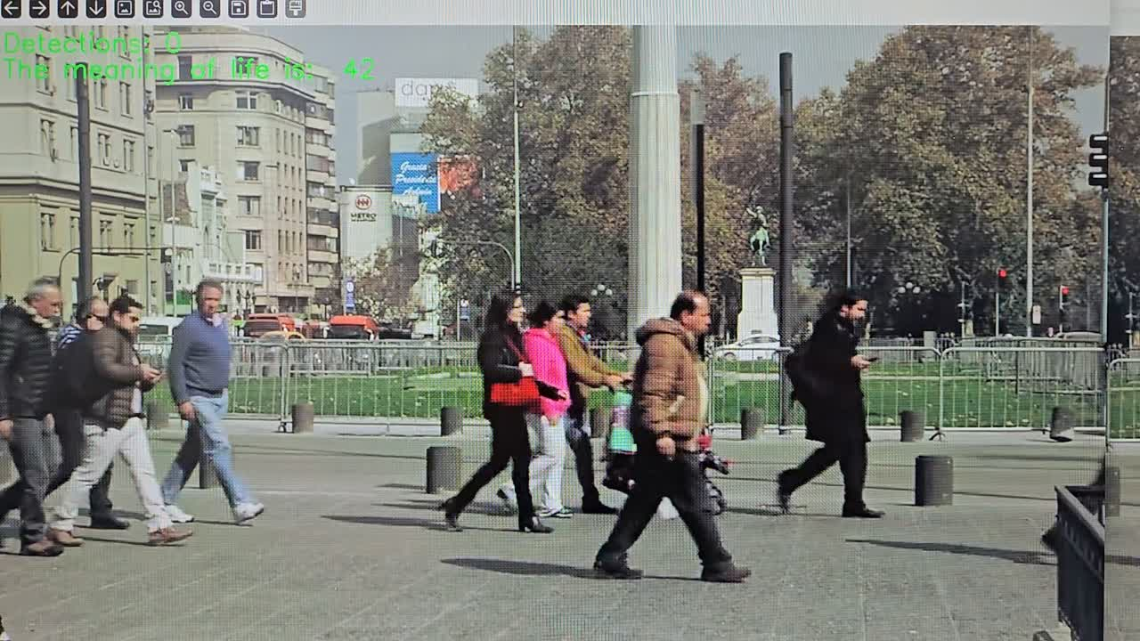
CURRENT OUTPUT

Slide 5

MILESTONE 3 TASK MATRIX
Task | Sloan
Post Processing Scripts | Finish Writing
8-bit Representation | Demonstrate
4-bit Representation | Implement

Slide 6

THANK YOU!
QUESTIONS?

